Slide 1
Kubernetes Senario

Slide 2
Senario 1
Create a namespace
Create a Nginx Deployment
Create a Nginx Service
Expose and access the Nginx Service

Slide 3
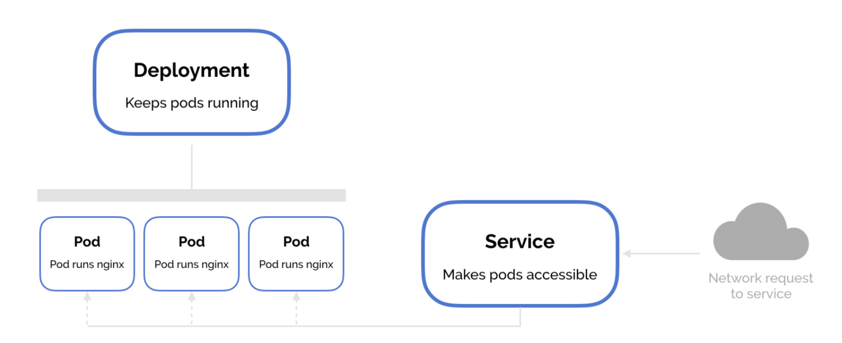
Senario 1

Slide 4
How to access Pod with nodeport
Senario 1
minikube service -n [NAMESPACE] --url NAME

Slide 5
Kubernetes Dashboard
minikube dashboard

Slide 6
Kubernetes network model

Slide 7
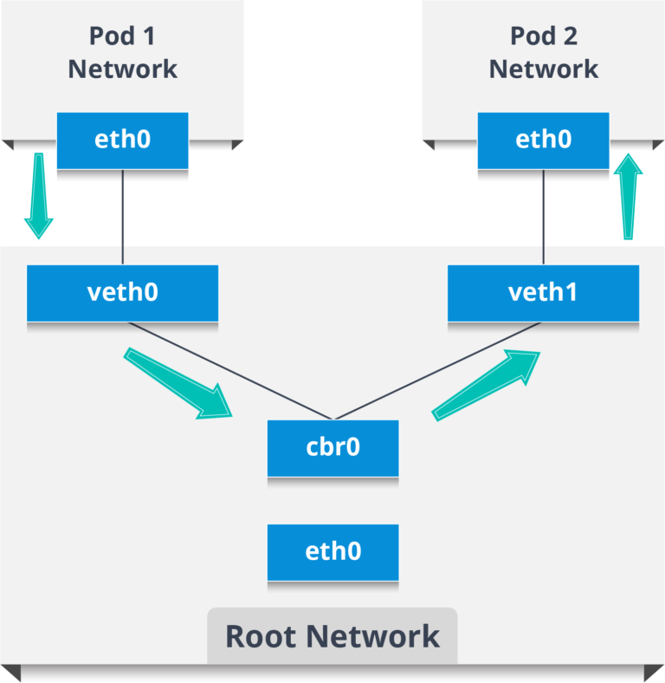
Intra-Node Pod Network

Slide 8
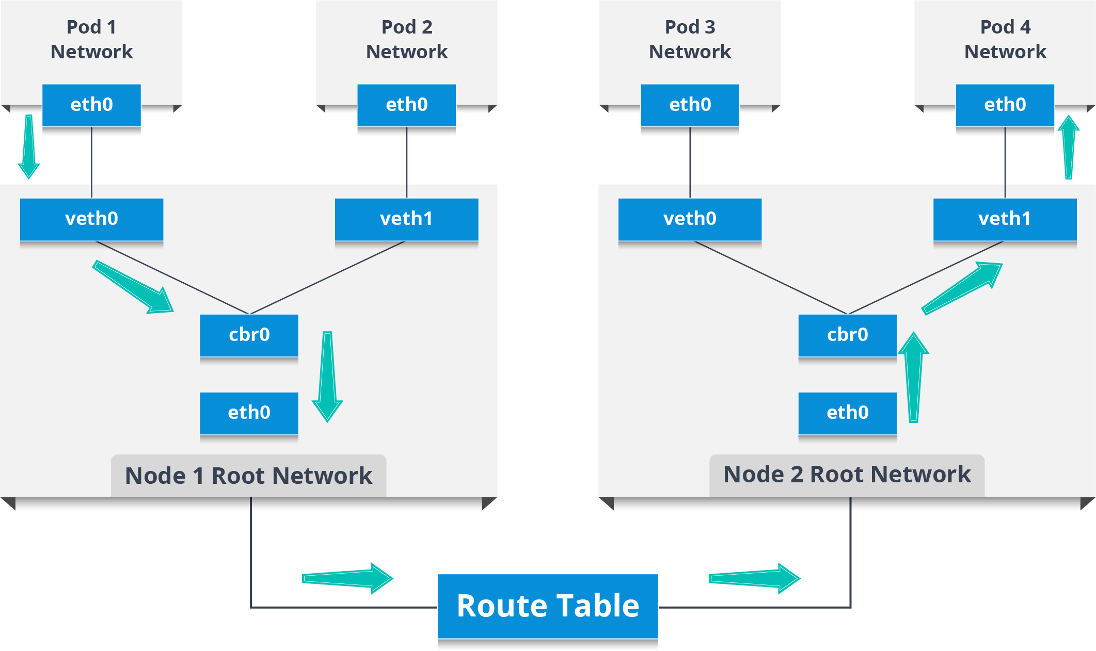
Inter-Node Pod Network

Slide 9
Types of Services
ClusterIP: This is the default service type which exposes the service on a cluster-internal IP by making the service only reachable within the cluster.
NodePort: This exposes the service on each Node’s IP at a static port. Since, a ClusterIP service, to which the NodePort service will route, is automatically created. We can contact the NodePort service outside the cluster.
LoadBalancer: This is the service type which exposes the service externally using a cloud provider’s load balancer. So, the NodePort and ClusterIP services, to which the external load balancer will route, are automatically created.

Slide 10
Senario-2
kubectl get deployment --namespace senario-2

Slide 11
Kubernetes secret
Senario-3
$ echo -n "A19fh68B001j" > ./apikey.txt
$ kubectl create secret generic apikey --from-file=./apikey.txt
secret "apikey" created

Slide 12
Kubernetes secret
$ kubectl describe secrets/apikey
Name: apikey
Namespace: default
Labels: <none>
Annotations: <none>
Type: Opaque
Data
apikey.txt: 12 bytes

Slide 13
Create Pod
kubectl apply -f https://raw.githubusercontent.com/openshift-evangelists/kbe/master/specs/secrets/pod.yaml

Slide 14
Create Pod
$ kubectl exec -it consumesec -c shell -- bash
[root@consumesec /]# mount | grep apikey
tmpfs on /tmp/apikey type tmpfs (ro,relatime)
[root@consumesec /]# cat /tmp/apikey/apikey.txt
A19fh68B001j

Slide 15
Delete Pod and secret
kubectl delete pod/consumesec secret/apikey

Slide 16
Senario-4
Multi-container pods and container communication in Kubernetes

Slide 17
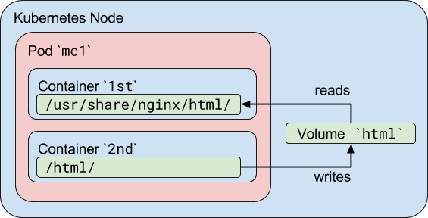
Senario-4
kubectl exec mc1 -c 1st -- /bin/cat /usr/share/nginx/html/index.html
kubectl exec mc1 -c 2nd -- /bin/cat /html/index.html

Slide 18
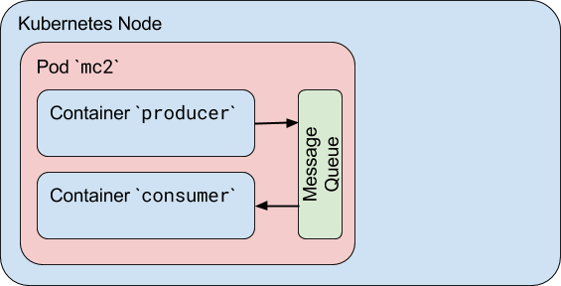
Inter-process communications (IPC)
$ kubectl get pods --show-all -w
NAME READY STATUS RESTARTS AGE
mc2 0/2 Pending 0 0s
mc2 0/2 ContainerCreating 0 0s
mc2 0/2 Completed 0 29

Slide 19
Inter-process communications (IPC)
$ kubectl logs mc2 -c producer
Produced: f4
Produced: 1d
Produced: 9e
Produced: 27
$ kubectl logs mc2 -c consumer
Consumed: f4
Consumed: 1d
Consumed: 9e
Consumed: 27
Consumed: done

